Slide 1
Handwritten to Text convertor using Deep Learning
M.Keerthana (1602-17-735-075)
MD Shadaab Farhan (1602-17-735-083)
A.Prashanth (1602-17-735-316)
Mentored By: S. Aruna Deepthi

Slide 2
Aim: Handwritten to Text Convertor
Programming language: Python Language
Packages:
1. NumPy
2. TensorFlow
3. OpenCV
4. Matplotlib

Slide 3
NumPy: NumPy, which stands for Numerical Python, is a library consisting of multidimensional array objects and a collection of routines for processing those arrays. Using NumPy, mathematical and logical operations on arrays can be performed.
TensorFlow: TensorFlow is an open-source software library for dataflow programming across a range of tasks. It is a symbolic math library, and also used for machine learning applications such as neural networks.
OpenCV is a huge open-source library for computer vision, machine learning, and image processing. OpenCV supports a wide variety of programming languages like Python, C++, Java, etc. It can process images and videos to identify objects, faces, or even the handwriting of a human.
Matplotlib is one of the most popular Python packages used for data visualization. It is a cross-platform library for making 2D plots from data in arrays. It provides an object-oriented API that helps in embedding plots in applications using Python GUI toolkits such as PyQt, WxPythonotTkinter. It can be used in Python and IPython shells, Jupyter notebook and web application servers also.

Slide 4
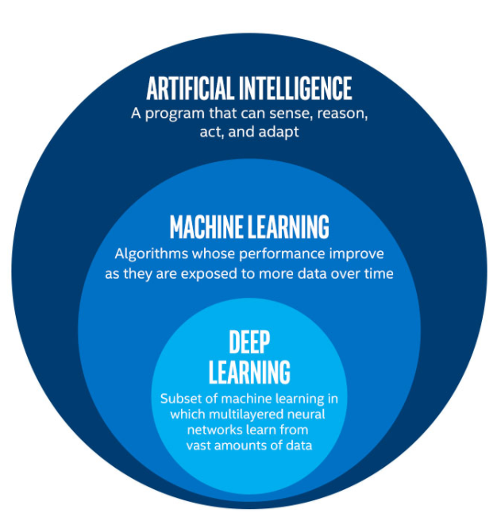
What is Deep Learning?
Deep learning is an artificial intelligence (AI) function that imitates the workings of the human brain in processing data and creating patterns for use in decision making.
Deep learning is a subset of machine learning in artificial intelligence that has networks capable of learning unsupervised from data that is unstructured or unlabeled.
Also known as deep neural learning or deep neural network.

Slide 5
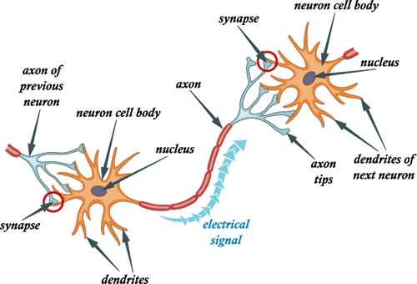
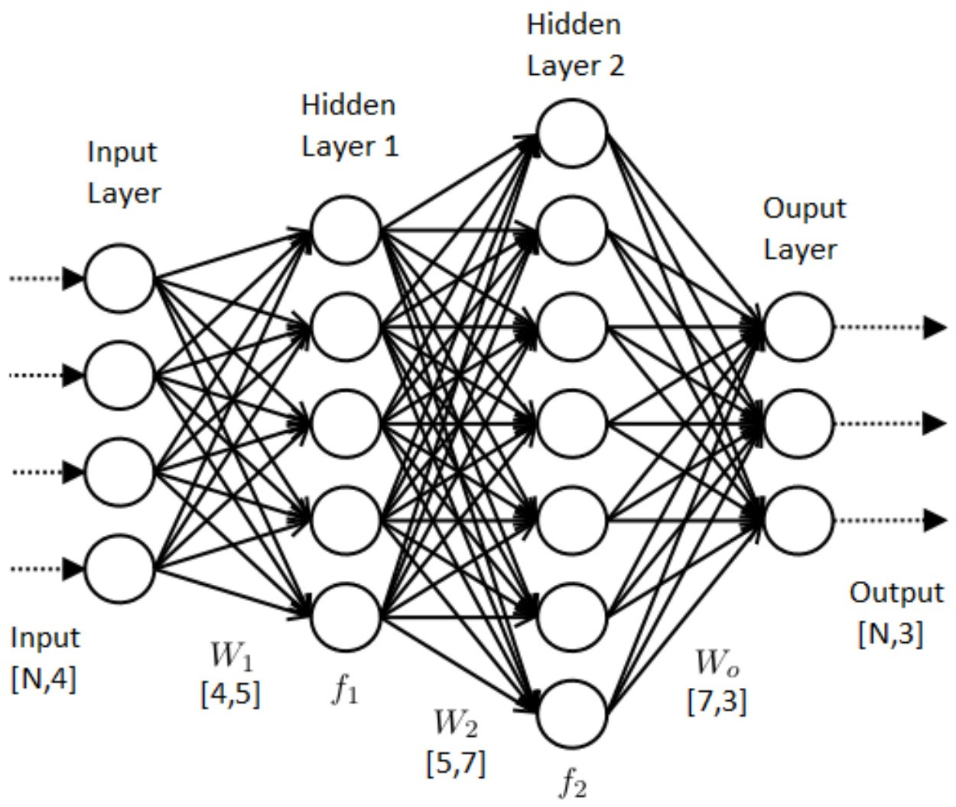
What is an artificial neural network?

Slide 7
Many handwriting recognition tools have been in the market since 70’s, but still, there are not many tools that give maximum accuracy as each person owns a unique style of writing, pressure and tilt.
There are two ways to recognize characters: Markov model and ANN (Artificial Neural Networks). Deep learning enables us to train and test the model with huge datasets, thus leading to maximum accuracy.
In this model, we have used neural network consisting of 5 CNN (Convolutional Neural Network) layers and 2 RNN (Recurrent Neural Network) layers and CTC model to decode.

Slide 8
Literature survey
K.Gaurav Bhatia, in his paper writes that, early pre-processing approaches in character detection with picture and complicated backgrounds are covered. He used some enhancing methods such as binarization, contrast stretching. In order to maintain high accuracy, he proposed multi pre-processing technique.
Salvador España-Boquera, In his paper for identifying the unconstrained offline handwritten texts a HHM model is suggested in this paper, structural model was represented with Markov chains with the help of supervised methods and multiple methods which will help to eliminate slant and slope form
A.Brakensiek: This work describes an off-line cursive handwriting detection system based on HMM that employs discrete and hybrid modelling techniques. Handwriting recognition studies are contrasted using a discrete technique and two alternative hybrid approaches that combine discrete and semi-continuous structures.
J.Pradeep: In this, character recognition has been proposed. It is based on the ANN paradigm. This Neural recognition system is built utilising two approaches, one with 54 features and the other with 69 features. To compare the recognition effectiveness of the recommended diagonal strategy of feature extraction, the neural network recognition system is trained using horizontal and vertical feature extraction

Slide 9
Sandhya Arora :- Intersection, chain code histogram, shadow features, and straight line fitting features were employed as feature extraction approaches. Chain code histogram features, Intersection features, and line fitting features are calculated by segregating the character image into distinct segments, while shadow features are calculated for the character image at a global level
Mohammed Z.khedar :- this work describes an off-line cursive handwriting detection system based on HMM that employs discrete and hybrid modelling techniques. Handwriting recognition studies are contrasted using a discrete technique and two alternative hybrid approaches
O.V. Ramana Murthy :- have published a work that shows how to recognise handwritten Hindi and English digits by modelling them as exponential membership functions that act as a fuzzy model. Altering the exponential membership functions outfitted to the fuzzy sets allows for detection.
R. Bajaj, L. Dey, S. Chaudhari :- For the classification of Devanagari numerals, researchers used three different types of characteristics: moment features, density features, and component descriptive features. For handwritten Devanagari numerals, they presented a multi classifier connectionist design to improve recognition dependability, and they achieved 89.6% accuracy.

Slide 10
The project tries to create software for recognition of a handwritten text from photos. It uses computer vision and machine learning.
Process of recognition is divided into 4 steps. The initial input is a photo of page with text.
1. Image Acquisition
2. Image Pre-processing
3. Feature Extraction (CNN)
4. RNN
5. CTC loss calculation and CTC decoding

Slide 11
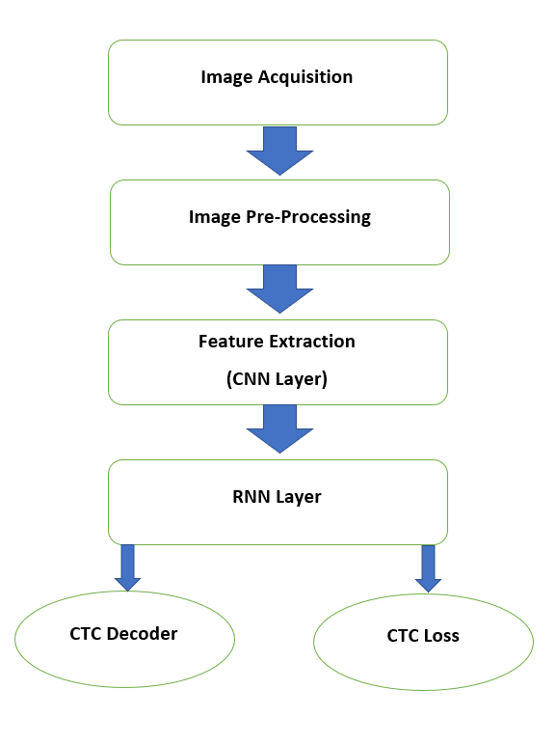
Flowchart

Slide 12
Image acquisition
The first step of any HCR system is image acquisition. In image acquisition, the scanned picture or image of the handwritten content is obtained. This can be done offline by using a scanner, photographs or by directly writing on computer using stylus.

Slide 13
Image Pre-processing
Its main objective is to normalize strokes and remove any variation in the handwritten image.
These variations or distortions are many types such as tilt in the handwriting, jitters in the text etc., will be corrected in image pre-processing.

Slide 14
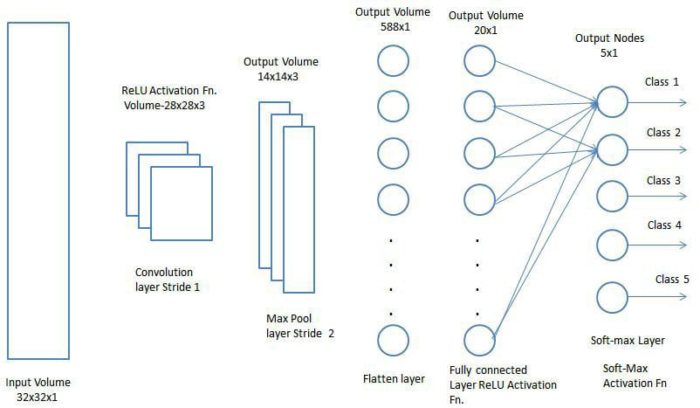
Feature Extraction (CNN)
Convolutional Neural Network:
A Convolutional Neural Network is a Deep Learning algorithm which is capable of taking in an input image, assign significance to different aspects/objects within the image and be capable of differentiating from one to other.

Slide 15
Features are unique characteristics of a word/character that help us to recognize a character/word and distinguish it.
The main aim of feature extraction step is to extract the pattern which is most suitable for classification.
In our project, feature extraction is done using 5 Convolutional Neural Networks (CNN) .

Slide 16
Recurrent Neural Network (RNN)
RNN deals with chronological data to detect temporal pattern and produce results.
It connects the same output to the hidden layers in opposite direction.
The output layer of RNN will acquire knowledge from both past and future simultaneously.

Slide 17
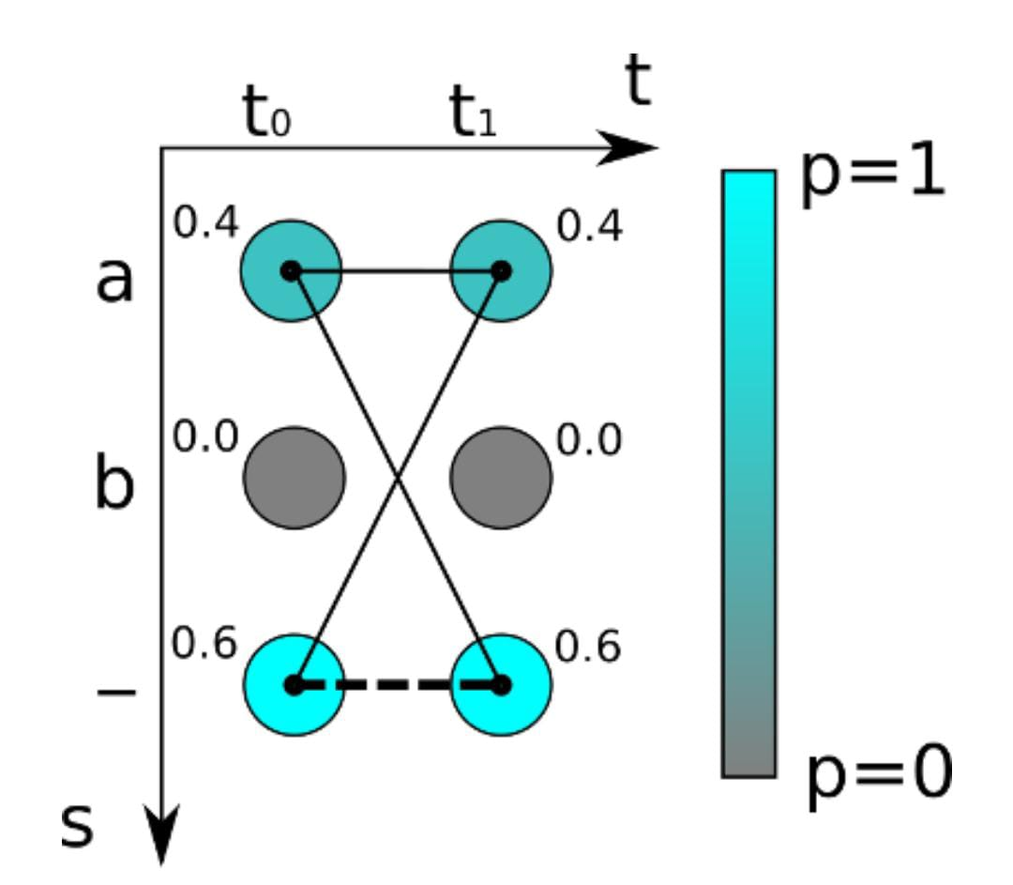
Connectionist Temporal Classification (CTC)
The NN training will be guided by the CTC loss function. In this, the feed the output matrix of the NN and corresponding ‘ground truth text’.
CTC will resolve the pseudocode character.

Slide 18
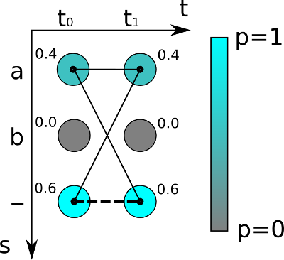
CTC Loss or Probability :
We feed the output matrix of the NN and the corresponding ground-truth (GT) text to the CTC loss function.
We know that the NN outputs a matrix containing a score for each character at each time-step.
Loss is calculated by summing up all scores of all possible alignments of the GT text
In the figure shown above, the score for the path “aa” is 0.4·0.4=0.16 while it is 0.4·0.6=0.24 for “a-” and 0.6·0.4=0.24 for “-a”.
Let’s assume the GT text is “a” in the example: we have to calculate all possible paths of length 2 (because the matrix has 2 time-steps), which are: “aa”, “a-” and “-a”. We already calculated the scores for these paths, so we just have to sum over them and get 0.4·0.4+0.4·0.6+0.6·0.4=0.64.

Slide 19
Result
Recognized: "put down a resouution on the subject"
Probability: 0.3410680592060089

Slide 20
Recognized: "A MOVE to stop Mr.Gaitskell from"
Probability: 0.4538659006357193

Slide 21
Recognized: "nomiuating any more Labour life Peers"
Probability: 0.21466925740242

Slide 22
Conclusion
In this project, a Neural Network is build using deep learning which is able to recognize handwritten content in an image and convert it into a digitalised text.
The NN consists of 5 CNN layers and 2 RNN layers whose output is a matrix which is given to CTC loss calculator and CTC decoder.
IAM Dataset was used for the entire project:
Accuracy: The Character Error Rate (CER) is 10.72% after 50 epochs of training, while the Word Error Rate (WER) is 26.45%, resulting in a Word Accuracy of 73.55%.
Training Set | Validation Set | Test Set
1364 | 80 | 160

Slide 23
Future scope
Data augmentation: We can increase the dataset size by randomly applying transformations to the already existing input images.
Deslanting: The cursive writing style in the input photos can be removed.
Adding a greater number of CNN layers.
Replacing LSTM by 2D-LSTM.
Decoder: To limit the output to dictionary terms, utilise token passing or word beam search decoding.
Text correction: If the identified word isn't found in a dictionary, look for the closest match.

Slide 24
References
[1] K. Gaurav and Bhatia P. K., “Analytical Review of Preprocessing Techniques for Offline Handwritten Character Recognition”, 2nd International Conference on Emerging Trends in Engineering & Management, ICETEM, 2013.
[2] Salvador España-Boquera, Maria J. C. B., Jorge G. M. and Francisco Z. M., “Improving Offline Handwritten Text Recognition with Hybrid HMM/ANN Models”, IEEE Transactions on Pattern Analysis and Machine Intelligence, Vol. 33, No. 4, April 2011.
[3] A. Brakensiek, J. Rottland, A. Kosmala and J. Rigoll, “Offline Handwriting Recognition using various Hybrid Modeling Techniques & Character N-Grams”
[4] J. Pradeep, E. Srinivasan and S. Himavathi, “Diagonal Based Feature Extraction For Handwritten Alphabets Recognition System Using Neural Network”, International Journal of Computer Science & Information Technology (IJCSIT), Vol 3, No 1, Feb 2011.

Slide 25
[5] Sandhya Arora, “Combining Multiple Feature Extraction Techniques for Handwritten Devnagari Character Recognition”, IEEE Region 10 Colloquium and the Third ICIIS, Kharagpur, INDIA, December 2008.
[6] Mohammed Z. Khedher, Gheith A. Abandah, and Ahmed M. AlKhawaldeh, “Optimizing Feature Selection for Recognizing Handwritten Arabic Characters”, proceedings of World Academy of Science Engineering and Technology, vol. 4, February 2005 ISSN 1307-6884.
[7] M. Hanmandlu, O.V. Ramana Murthy, “Fuzzy model-based recognition of handwritten numerals”, pattern recognition, vol.40, pp.1840-1854, 2007.
[8] Reena Bajaj, Lipika Dey, and S. Chaudhury, “Devnagari numeral recognition by combining decision of multiple connectionist classifiers”, Sadhana, Vol.27, part. 1, pp.-59-72, 2002.

Slide 26


